Slide 1
Remodeling
Industrial Technology
Education in California
CITEP
CALIFORNIA INDUSTRIAL TECHNOLOGY EDUCATION PROJECT

Slide 2
Purpose of Project
CITEP
Program development, support and professional development activities related to the five ITE sectors
Focus on upgrading curriculum
Implementation of CTE Standards & Framework
Building partnerships with business & industry

Slide 3
Industry Sectors
CITEP
Building Trades & Construction | Complete
A. Cabinetmaking & Wood Products* | Sequence; 1 Course
B. Engineering & Heavy Construction* | 1 Course
C. Mechanical Construction | 1 Course
D. Residential & Commercial Construction | Sequence 3 Courses
Energy & Utilities | Complete
A. Electromechanical Installation & Maintenance
B. Energy & Environmental Technology | Sequence; 3 Courses
C. Public Utilities* | 1 Course
D. Residential & Commercial Energy & Utilities
* CTEOnline

Slide 4
Industry Sectors
CITEP
Engineering & Design | Complete
A. Architecture & Structural Engineering | Sequence; 3 Courses
B. Computer Hardware, Electrical & Network Engineering | Sequence; 4 Courses
C. Engineering Design (CAD/CAM)* | 1 Course
D. Engineering Technology (Robotics)* | 1 Course
Manufacturing & Product Development | Complete
A. Graphic Arts Technology | Sequence; 3 Courses
B. Integrated Graphics (Multimedia)
C. Machine & Forming Technology
D. Welding Technology* | 1 Course
* CTEOnline

Slide 5
Industry Sectors
CITEP
Transportation | Complete
A. Aviation & Aerospace
B. Collision Repair & Refinishing
C. Vehicle Maintenance, Service & Repair* | Sequence; 3 Courses
* CTEOnline

Slide 6
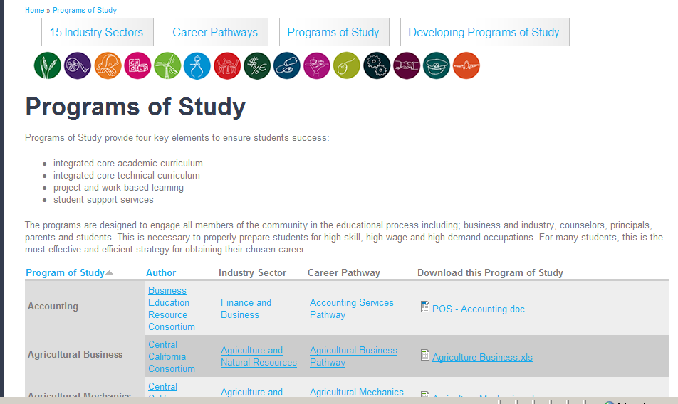
Resources for Sequence Development
CITEP
www.statecenter.com/industry sectors

Slide 7
Resources con’t
CITEP
www.statewidepathways.org

Slide 8
Course Sequences
CITEP
Cabinetmaking & Wood Products Pathway
CTE Courses
Introductory | Concentration | Capstone
Cabinetmaking 1 Woodworking I Introduction to Wood | Woodworking 2 Woodworking Processes Woodworking 3 Intermediate Woodworking | Woodworking 4 Advanced Woodworking
Residential and Commercial Construction Pathway
CTE Courses
Introductory | Concentration | Capstone
Introduction to Construction Building Trades | Construction Fundamentals Building Construction (Exterior) Residential & Commercial Construction Intermediate Construction | Building Construction (Exterior) Building Construction (Interior) Sustainable Construction Advanced Construction

Slide 9
CITEP
Energy and Environmental Technology Pathway
CTE Courses
Introductory | Concentration | Capstone
Intro to Green Technology/Energy | Green Technology I /Intro to Solar Green Technology II /Biofuels, Electricity, GeoThermal Energy Technology I | Advanced Topics in Green Technology Energy Technology
Architectural and Engineering Design
CTE Courses
Introductory | Concentration | Capstone
Architectural Design I | History of Art & Architecture Introduction to Engineering Design Computer Aided Drafting (CAD) | Advanced Architectural Design Structural and Architectural Design

Slide 10
CITEP
Computer Hardware, Electrical, and Networking Engineering Pathway
CTE Courses
Introductory | Concentration | Capstone
Computer & Network Fundamentals Introduction to Electricity / Digital Electronics Exploring Technology Technical Core Communication Technology | Computer and Communications Networking Computer Systems Design / Maintenance Electrical Codes and Systems Signal Communications Digital & Analog Electronics Electronic Systems Technology | Computer Networking and Administration Electrical / Electronic Technology Essentials of Information Technology Digital Video Security and Surveillance

Slide 11
CITEP
Graphic Arts Technology Pathway
CTE Courses
Introductory | Concentration | Capstone
Keyboarding/Computer Applications Introduction to Graphic Arts | Advanced Graphic Arts | Web Design Video Production Animation/Motion Graphics Commercial Art Commercial Photography

Slide 12
CITEP
Vehicle Service, Maintenance and Repair Pathway
CTE Courses
Introductory | Concentration | Capstone
Intro to Auto Auto 9 | Auto Technology Auto Systems Technology (Auto Tech 2) ASE1 Engine Repair ASE 4 Suspension & Steering ASE 5 Brakes ASE 7 Heating & Air Conditioning Auto 10 Auto 11 Engine Technology | Auto Systems Technology (Auto Tech 3) ASE1 Engine Repair ASE 4 Suspension & Steering ASE 2 Auto Transmission & Transaxle ASE 3 Manual Drive Train & Axle ASE 6 Electrical & Electronic Systems ASE 8 Engine Performance Auto 12

Slide 13
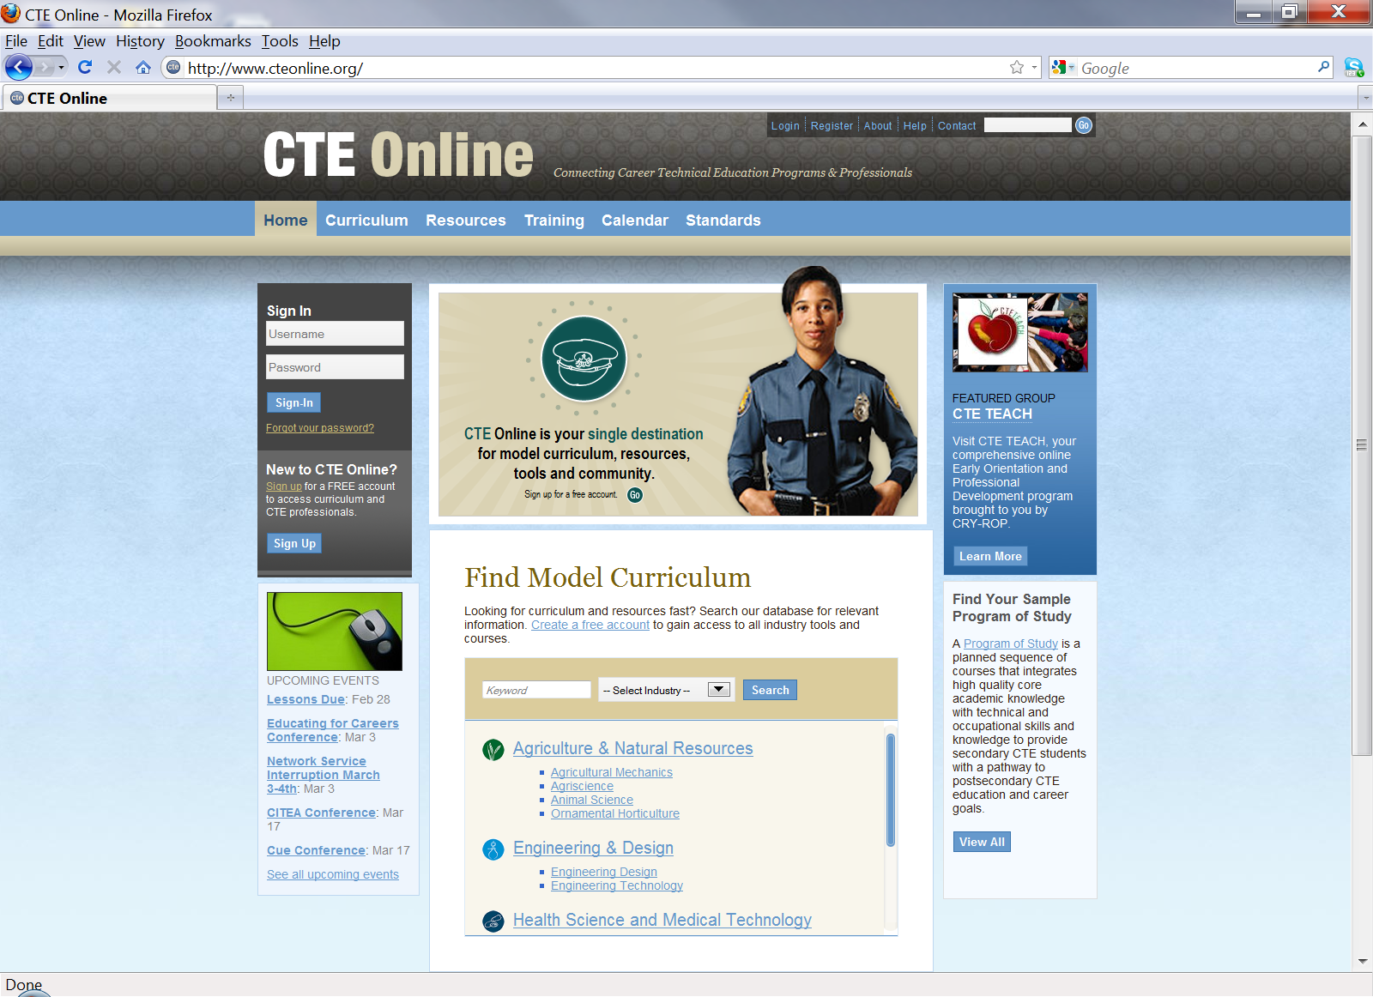

Slide 14
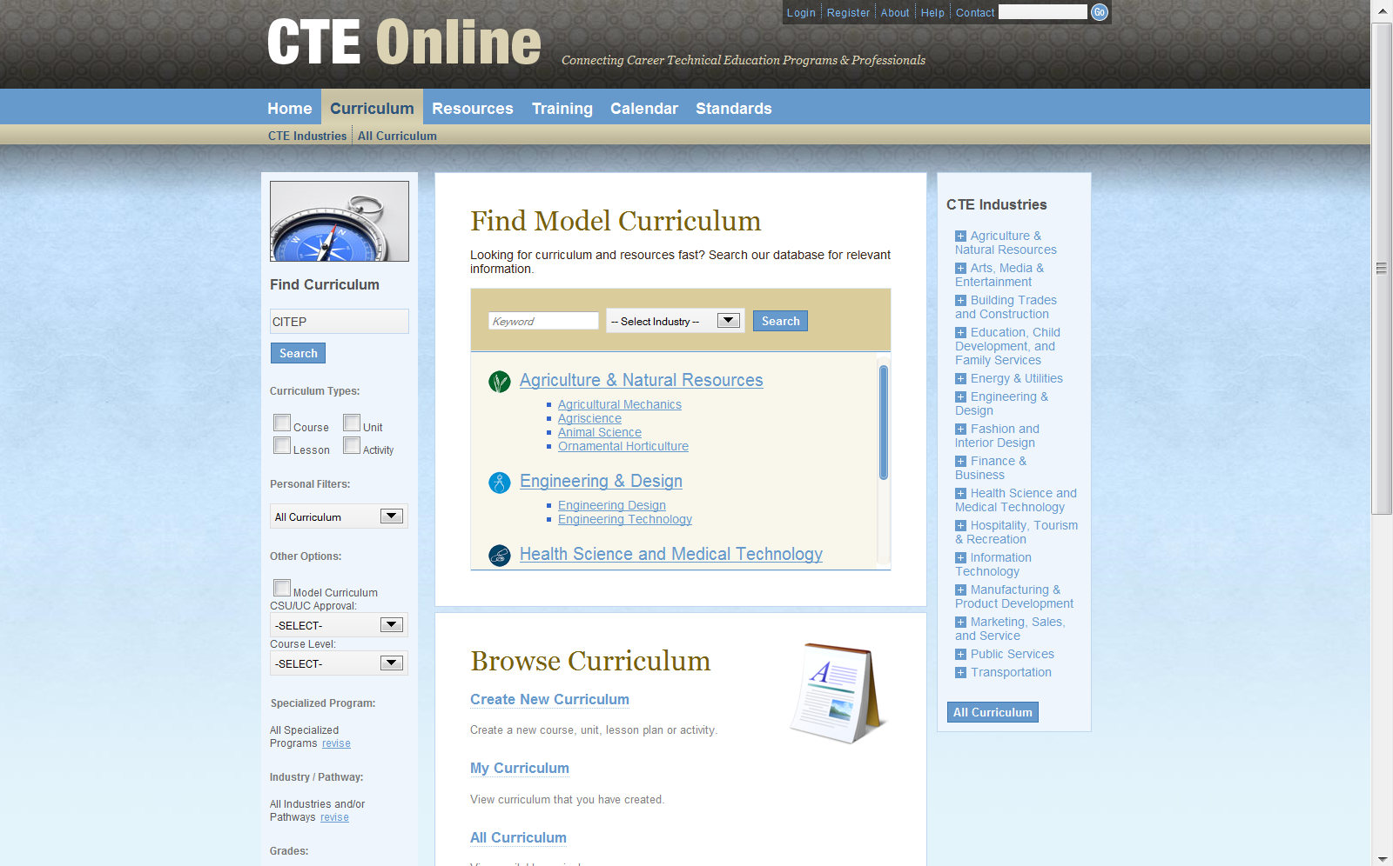
Type
CITEP in
Search Box

Slide 15
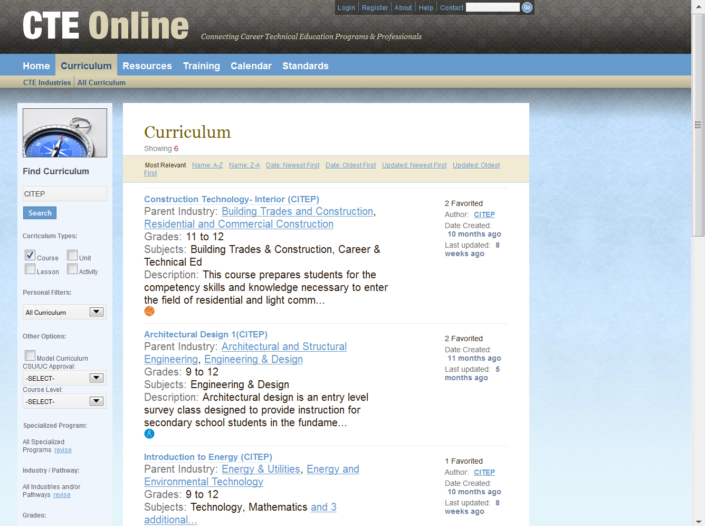
CITEP courses
are identified in
parentheses
at the end of the
course title

Slide 16
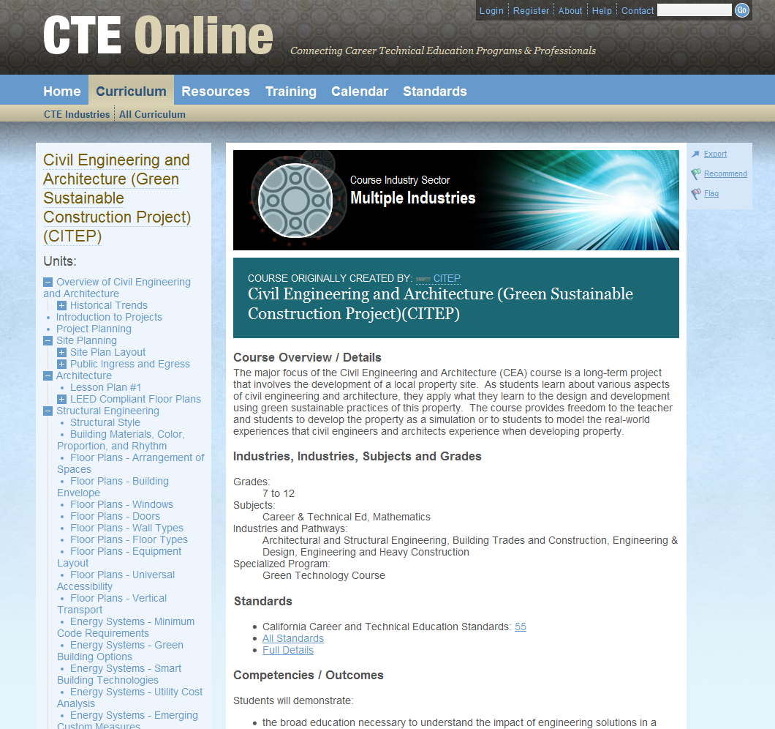

Slide 17
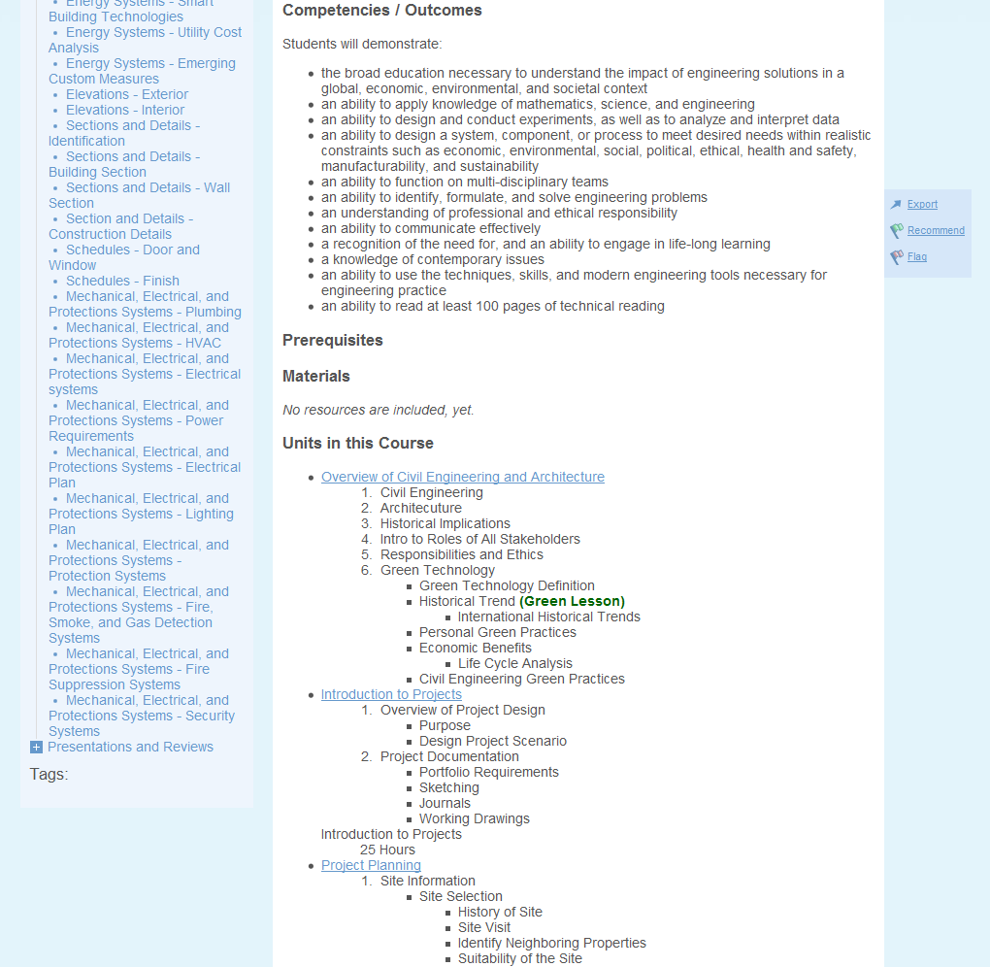

Slide 19
CITEP Teacher Partners
Building Trades & Construction | District | School | Pathway
David Eldridge | Marysville JUHSD | Lindhurst HS | Cabinetmaking & Woodworking
Chris Melgoza | Kerman USD | Kerman HS | Cabinetmaking & Woodworking
Daniel Ramirez | Kerman USD | Kerman HS | Residential & Commercial
Ralph Wigginton | Santa Clara COE | Lincoln HS | Residential & Commercial
Transportation | District | School | Pathway
Ramon Iniguez | Kerman USD | Kerman HS | Vehicle Maintenance
Jason Mulliken | Clovis USD | Clovis HS | Vehicle Maintenance
Steve Nagle | Kingsburg HSD | Kingsburg HS | Vehicle Maintenance

Slide 20
Energy & Utilities | District | School | Pathway
Veronica Davis | East Side UHSD | Overfelt HS | Energy & Environmental Tech
Jody Ewings | East Side UHSD | Independence HS | Energy & Environmental Tech
Angie Friedrich | Elk Grove USD | Laguna Creek HS | Energy & Environmental Tech
Jen Harris | Clovis USD | Buchanan HS | Energy & Environmental Tech
Allison Parker | East Side UHSD | Andrew Hill HS | Energy & Environmental Tech
Alexandria Smith | Clovis USD | Buchanan HS | Energy & Environmental Tech
Paul Lake | Clovis USD | Buchanan HS | Energy & Environmental Tech
Sarah Ashby | Corcoran USD | Corcoran HS | Energy & Environmental Tech
Manufacturing & Product Development | District | School | Pathway
Daniel Binsfeld | Kern HSD | Kern ROC | Graphic Arts Technology
Stephanie Duburg | Clovis USD | Clovis East HS | Graphic Arts Technology
Edmond Kwong | Fremont UHSD | Homestead HS | Graphic Arts Technology
Aaron Love | Clovis/Fresno USDs | CART | Graphic Arts Technology

Slide 21
Engineering & Design | District | School | Pathway
Brian Atwater | Kern HSD | East HS | Architectural & Structural Engineering
Fred Avila | Clovis USD | Clovis HS | Architectural & Structural Engineering
Karen Melander | San Francisco USD | Lincoln HS | Architectural & Structural Engineering
Halbert Bynum | Fresno/Clovis USDs | CART | Computer Hardware, et al
Jay Eichmann | Clovis USD | Clovis East HS | Computer Hardware, et al

Slide 22
CITEP
How can you get involved?
Sign-up today for e-mail notifications
Or e-mail CITEP CITEP@fcoe.org
Or Register with CTE Online & send a request to CITEP to share a specific course

